Slide 1
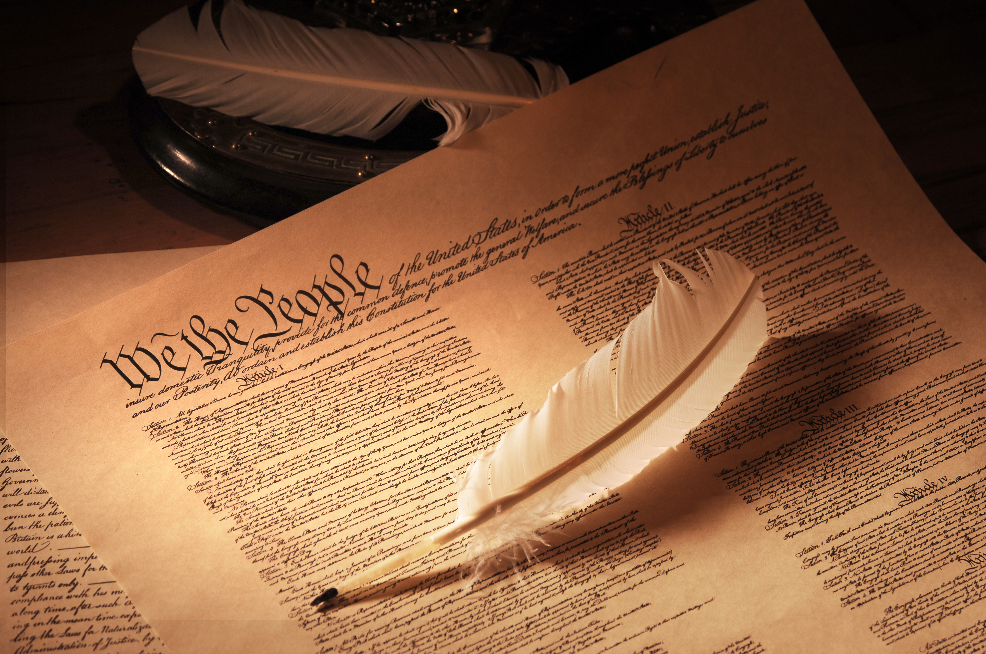
A Computational Analysis of Constitutional Polarization
David Pozen, Eric Talley & Julian Nyarko

Slide 2
Main Motivations
Growing literature on constitutional polarization … but little empiricism as of yet.
Growing literature on asymmetric constitutional polarization … but little empiricism as of yet.
Growing literature on the substance of such polarization (e.g., rise of originalism, First Amendment’s rightward turn) … but little empiricism as of yet.
Interesting ambiguity in constitutional theory as to whether framing arguments in constitutional terms should tend to (i) moderate, (ii) amplify, or (iii) reproduce ideological discord.

Slide 3
Heuristic Design

Slide 4
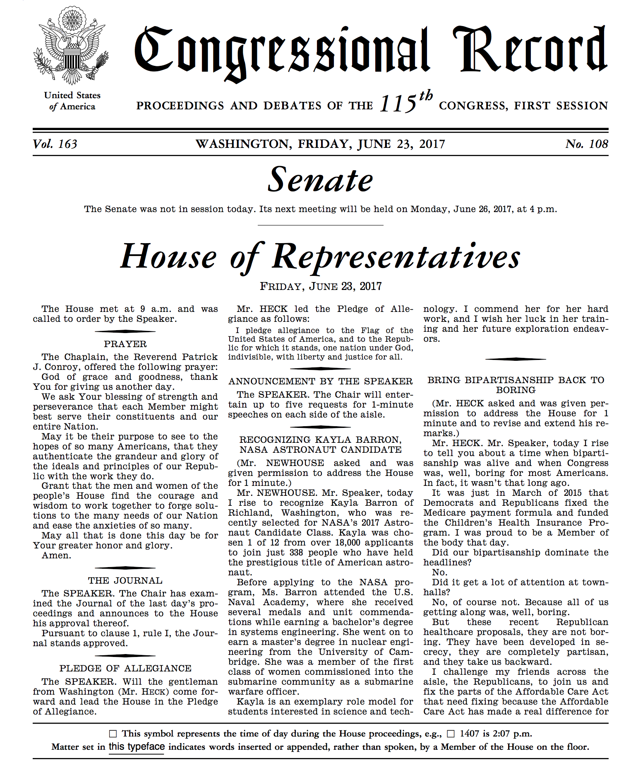
The Congressional Record
“Substantially verbatim transcript” of all remarks made during proceedings of the House and Senate
46th Congress (1873) – 114th Congress (ending Jan. 2017)
17.8 million documents, 1.9 billion words
No Extensions of Remarks

Slide 5
Summary Statistics (CR)

Slide 6
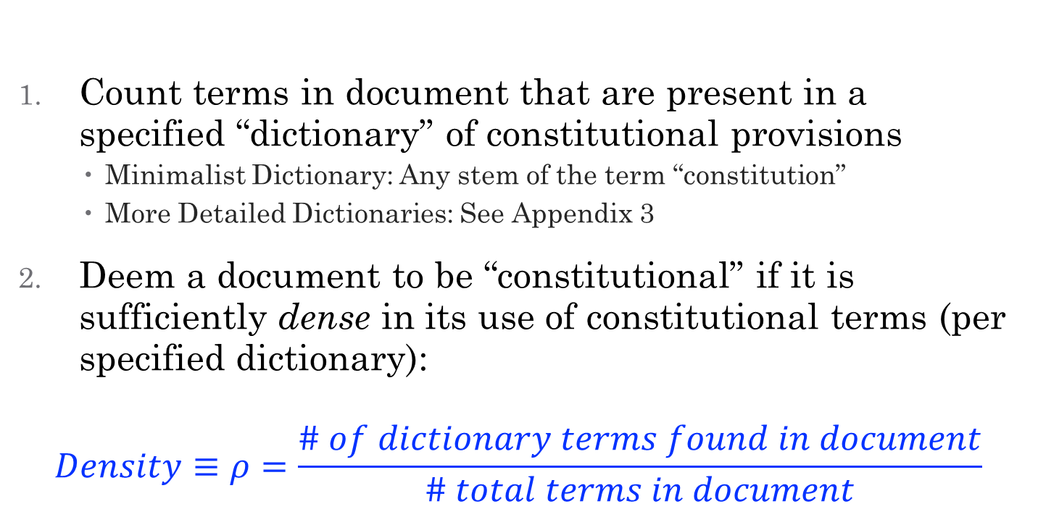
Distinguishing “Constitutional” from other Documents
Count terms in document that are present in a specified “dictionary” of constitutional provisions
    Minimalist Dictionary: Any stem of the term “constitution”
    More Detailed Dictionaries: See Appendix 3
Deem a document to be “constitutional” if it is sufficiently dense in its use of constitutional terms (per specified dictionary):
$$Density≡ρ=\frac{\# of dictionary terms found in document}{\# total terms in document}$$

Slide 7
Dictionary Definitions
Minimal: Contains term “constitution” and all variants and stems thereof (“constitutional,” “unconstitutional,” “nonconstitutional,” “extraconstitutional,” “constitutionally,” “unconstitutionally,” and so forth). Using the Minimal dictionary, a document would be deemed constitutional if and only if it explicitly mentions this term.
Textual: All of Minimal + This dictionary includes the Minimal dictionary and, in addition, the titles of all constitutional articles, amendments, and clauses, both in their standard legal formulations (e.g., “second amendment”) and well-recognized colloquialisms (e.g., “right to bear arms amendment”).
Extended Textual: Minimal + Textual + phrases appearing Constitution that lack common extraconstitutional usage (for example, “advice and consent,” “equal protection,” and “searches and seizures”).
Originalism: Terms associated with constitutional founding and Constitution’s original meaning (e.g., “founding fathers” “original intent,” and “philadelphia convention”).
Expansive: Minimal + Textual + Extended Textual + Originalism + over 100 important constitutional concepts at least several decades old (e.g., “administrative state,” “freedom of contract,” “judicial review,” “separate but equal,” and “separation of powers”).
Expansive
Extended Textual
Originalism
Textual
Minimal

Slide 8
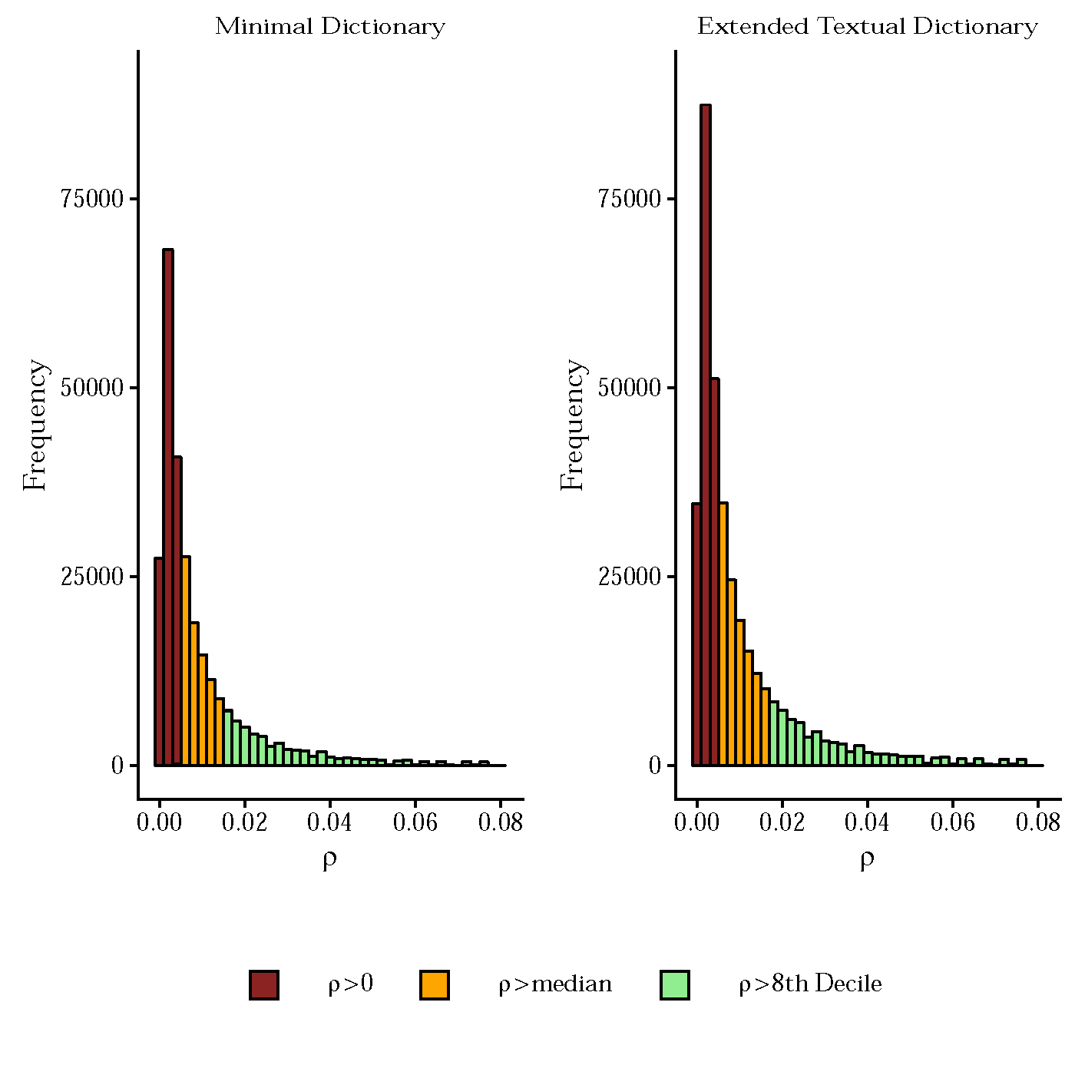
Distribution of ρ (conditional on ρ>0)

Slide 9
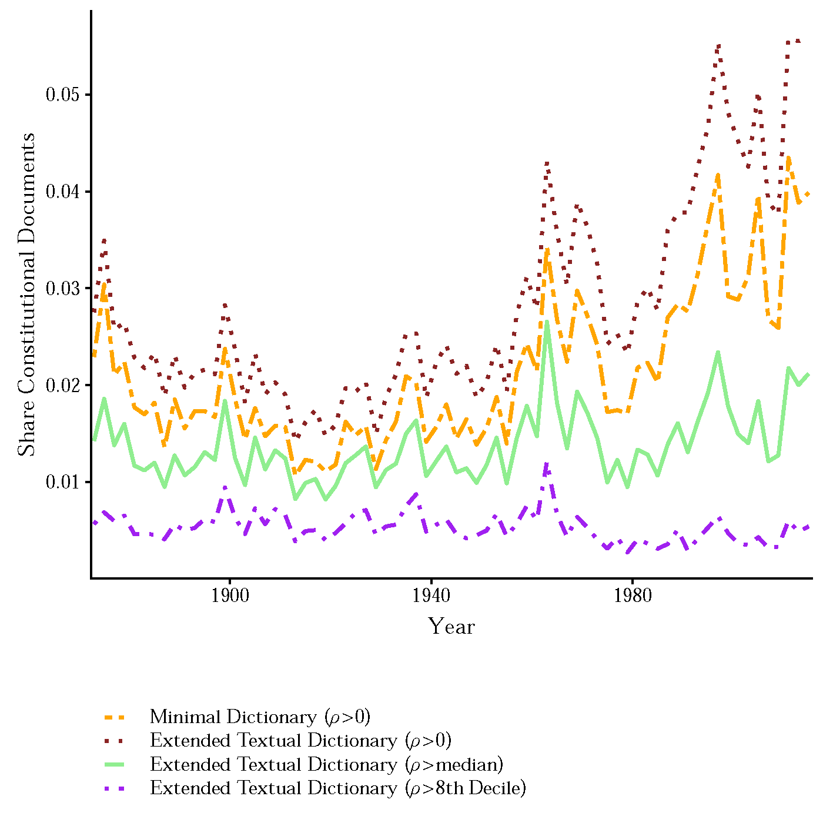
Share of Constitutional Documents

Slide 10




Measuring Political Partisanship:
Key Q: How well does a Machine-Learning Classifier Predict whether a speech came from a Democrat or Republican? (Constitutional v. non-constitutional documents; by Congress)

Slide 11
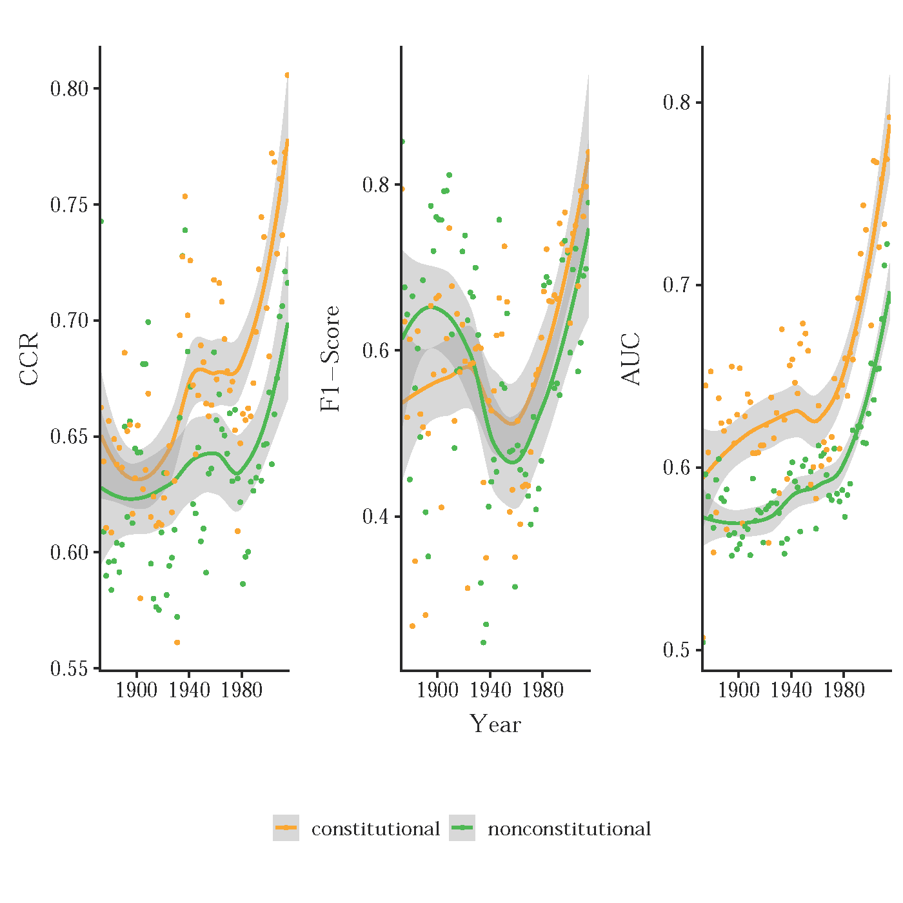
Classifier Performance Over Time
Minimal Dictionary; Predicting Party Affiliation

Slide 12
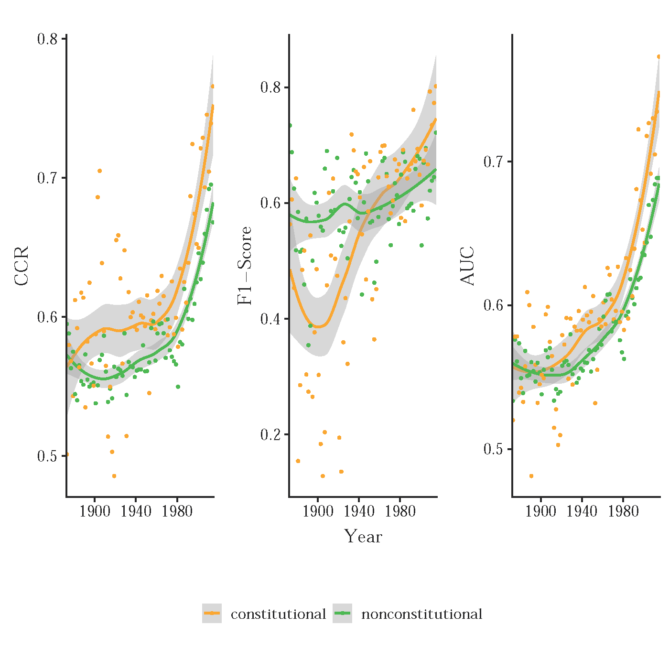
Classifier Performance Over Time
Minimal Dictionary; Predicting Binary P-R Ideology

Slide 13
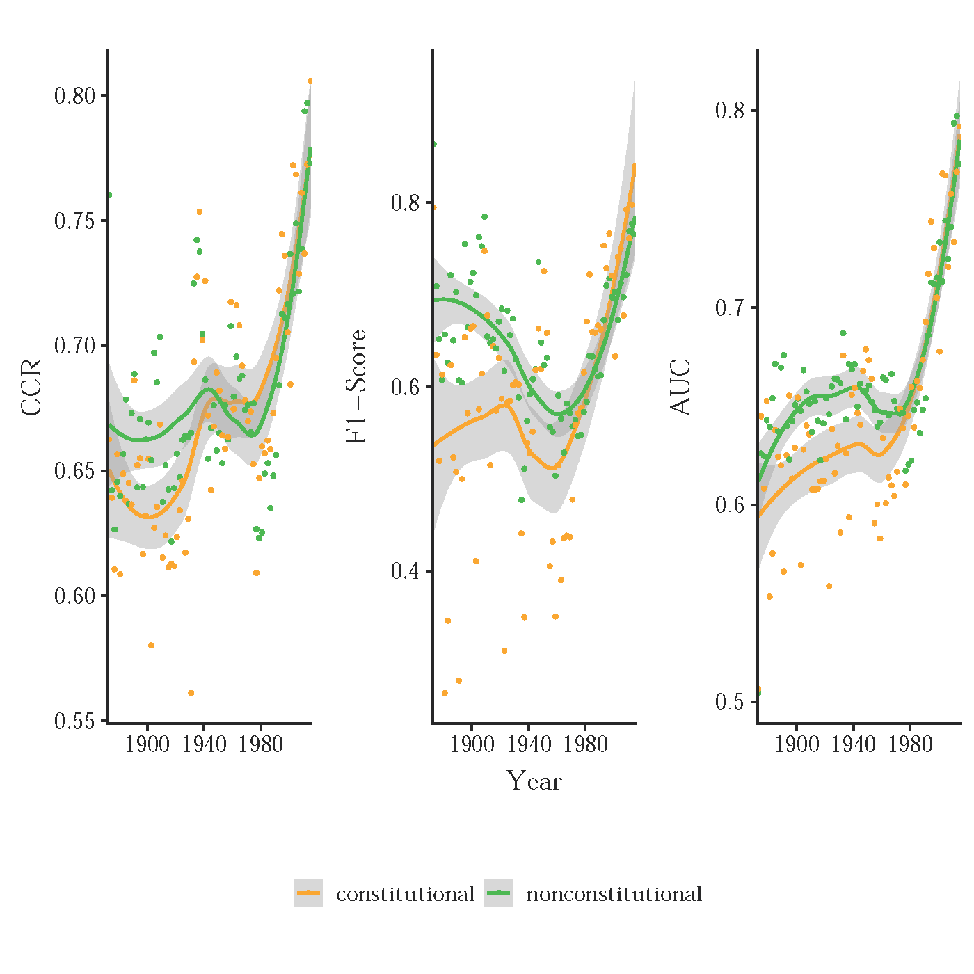
Classifier Performance Over Time
Minimal Dictionary; Predicting Party Affiliation
Length-Matched Samples

Slide 14
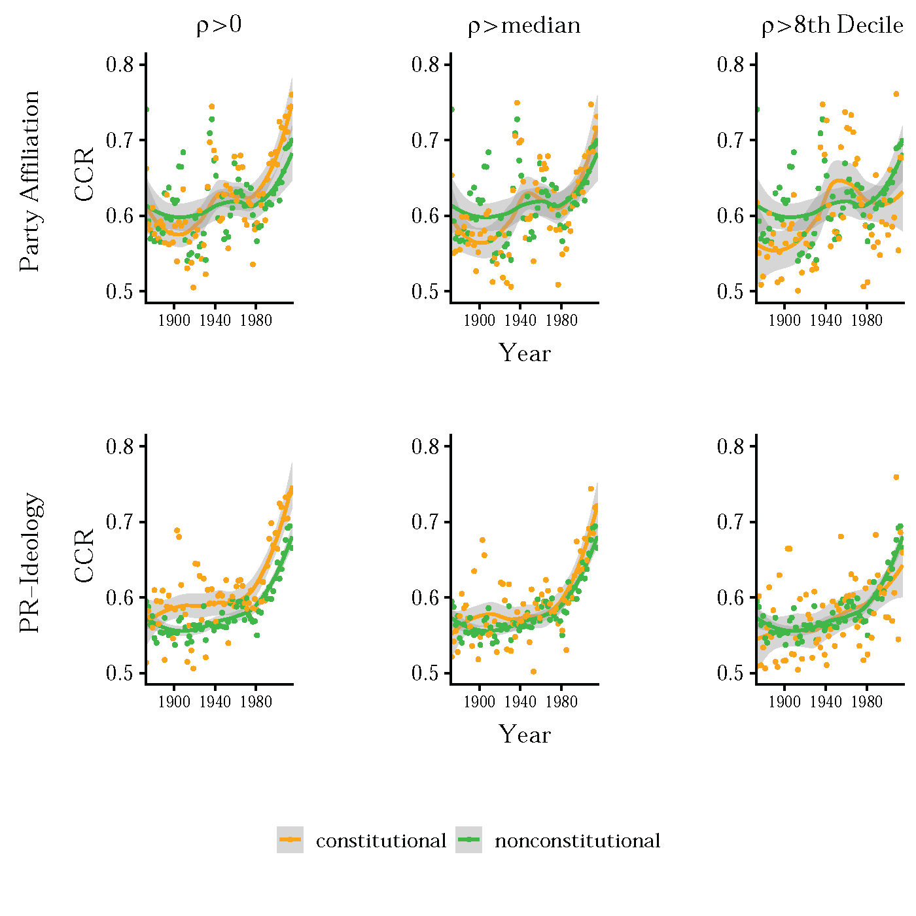
Classifier Performance Over Time
Extended Textual Dictionary; Predicting Party Affiliation

Slide 15
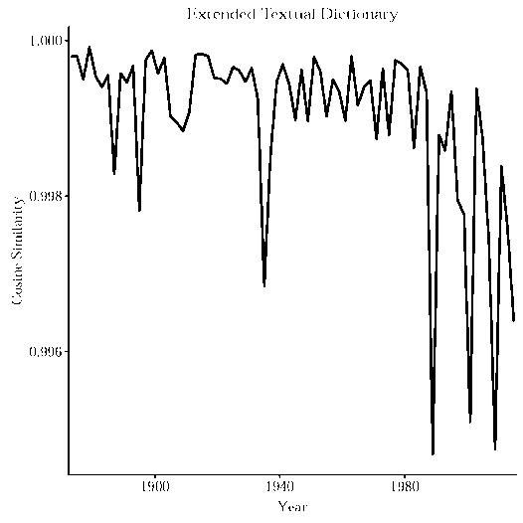
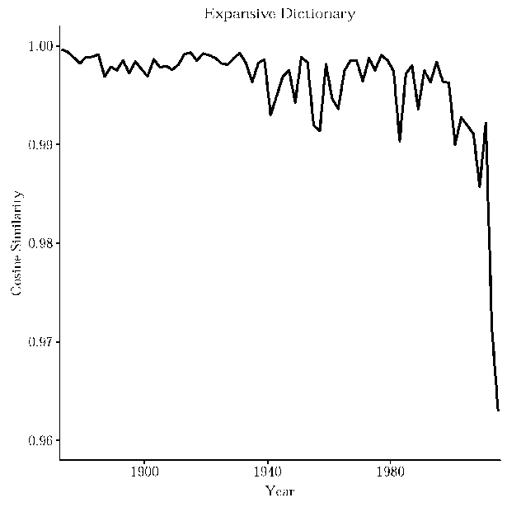
Talking Past One Another
Cosine Similarity; Constitutional Speech

Slide 16
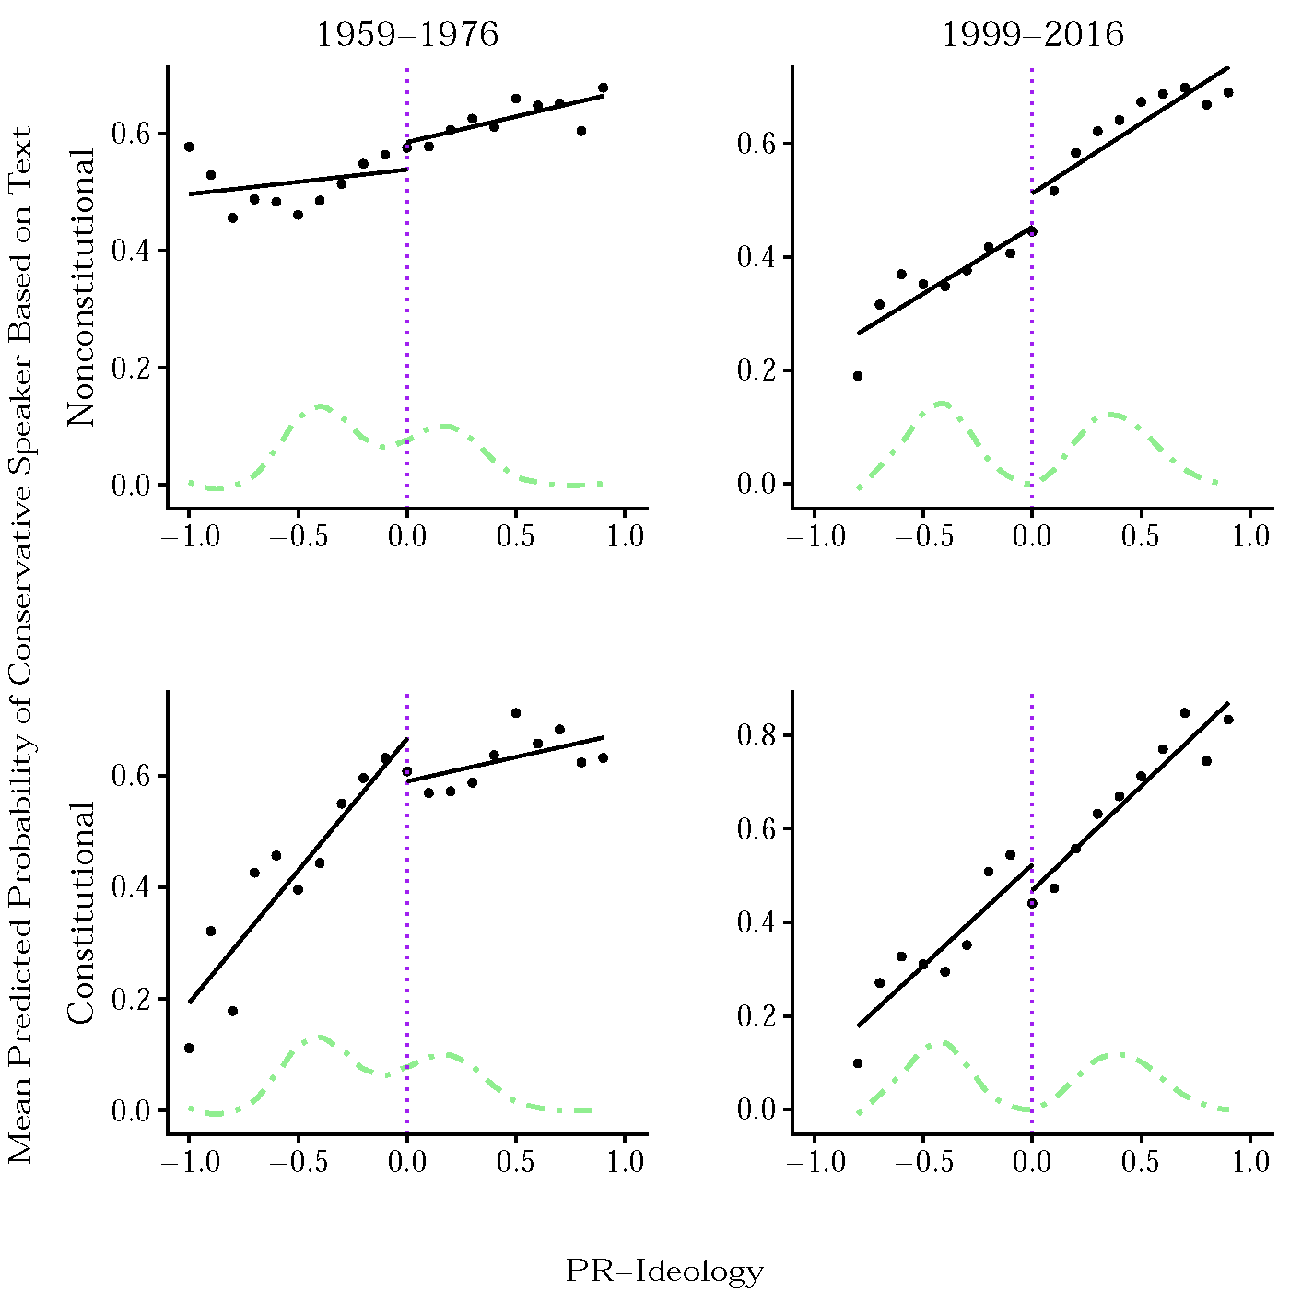
Probability of conservative speaker versus Poole Rosenthal scores (1 dim)

Slide 17
Voting Ideology and and Partisanship

Slide 18
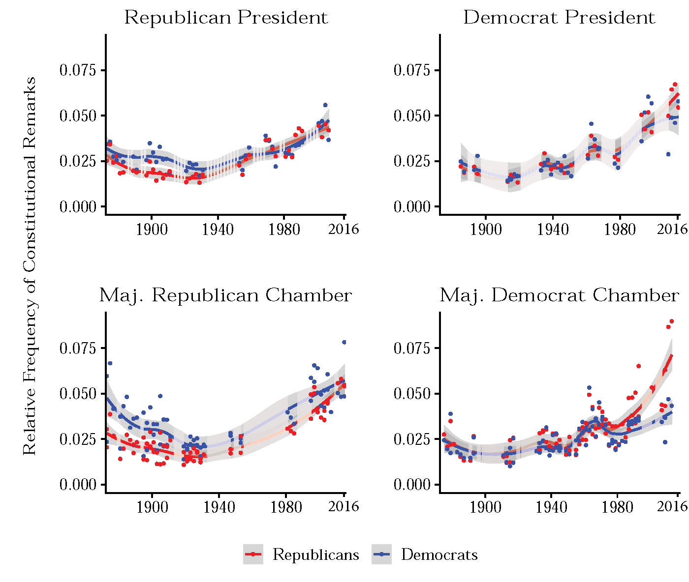
Counter-majoritarian Rhetoric

Slide 19
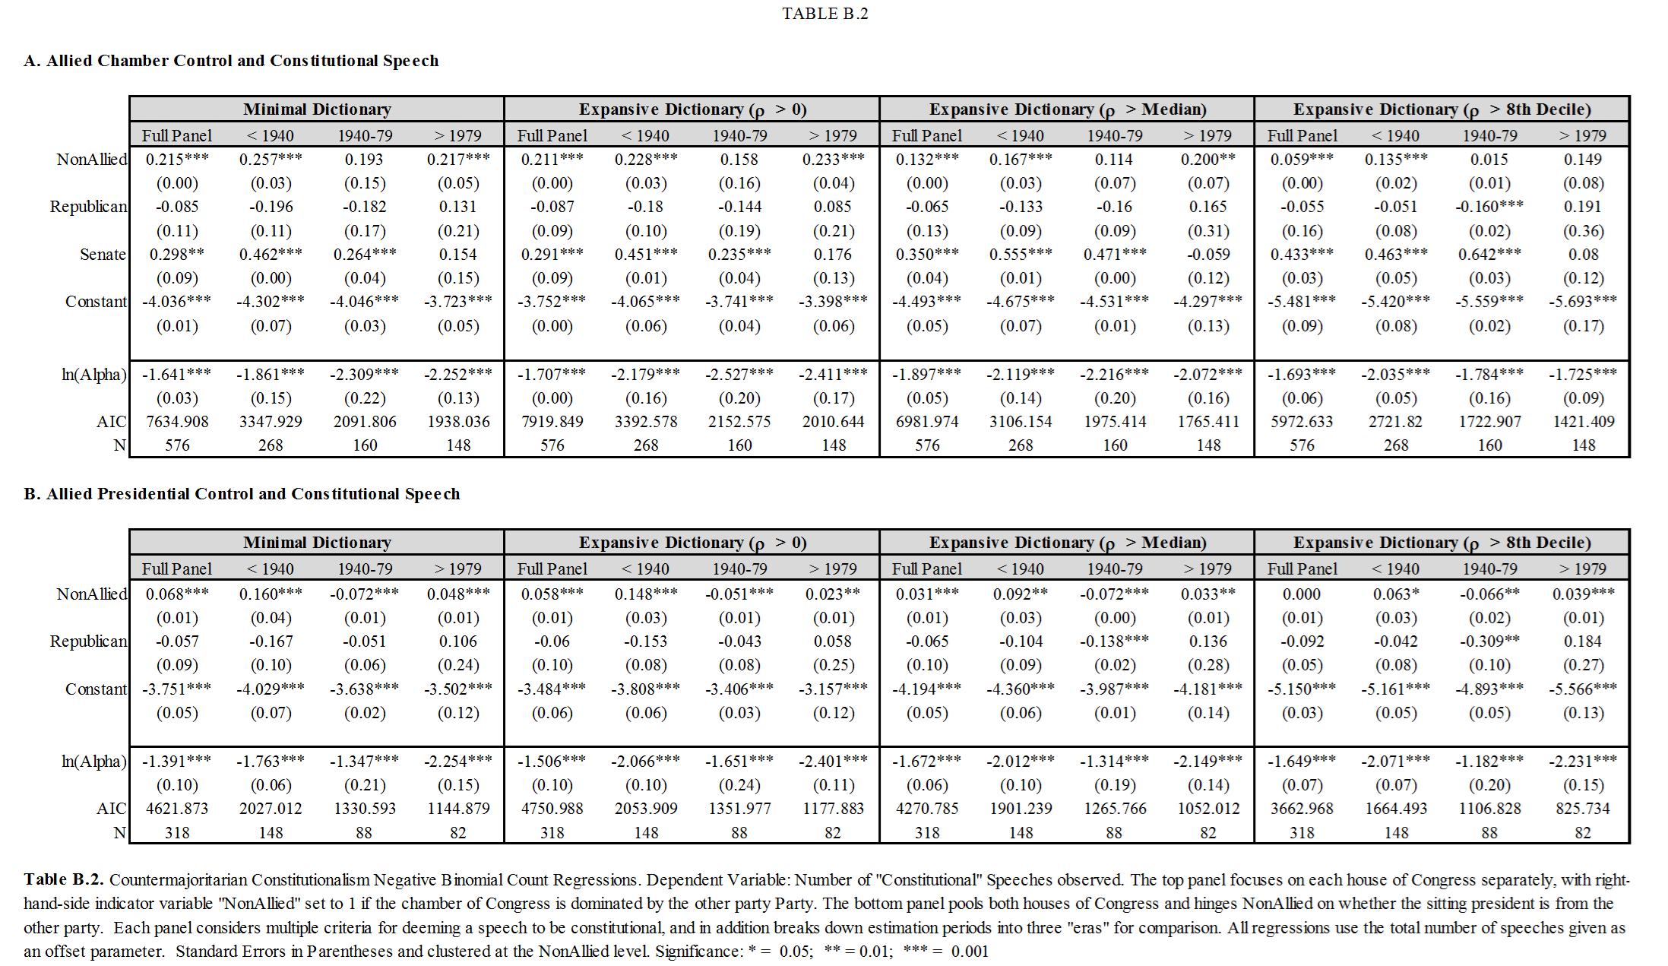
Counter-majoritarian Partisanship

Slide 20
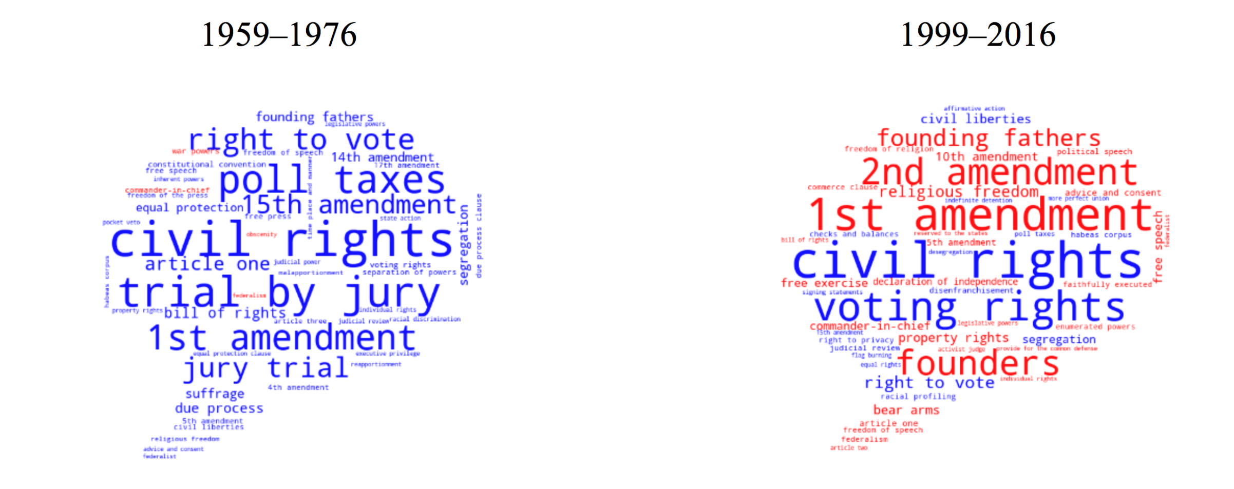
Who “Owns” Constitutional Terms?
Two Eras
Red: Republican
Blue: Democrat

Slide 21
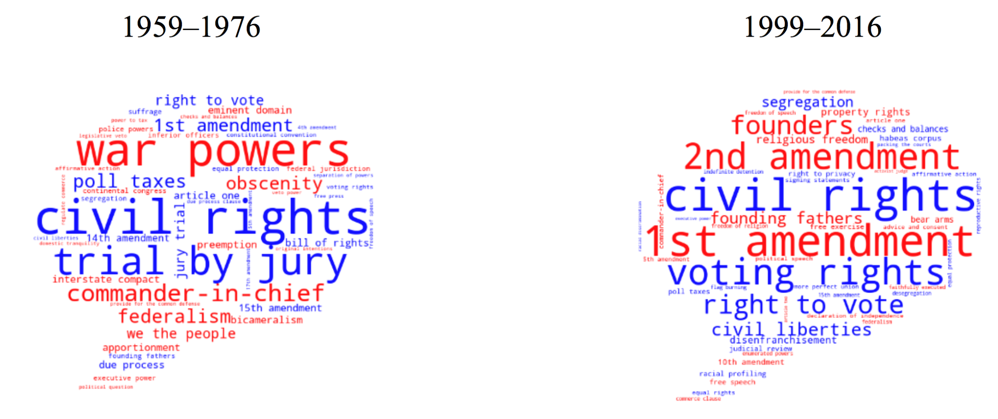
Who “Owns” Constitutional Terms?
(Top 25 for each party)
Red: Republican
Blue: Democrat

Slide 22
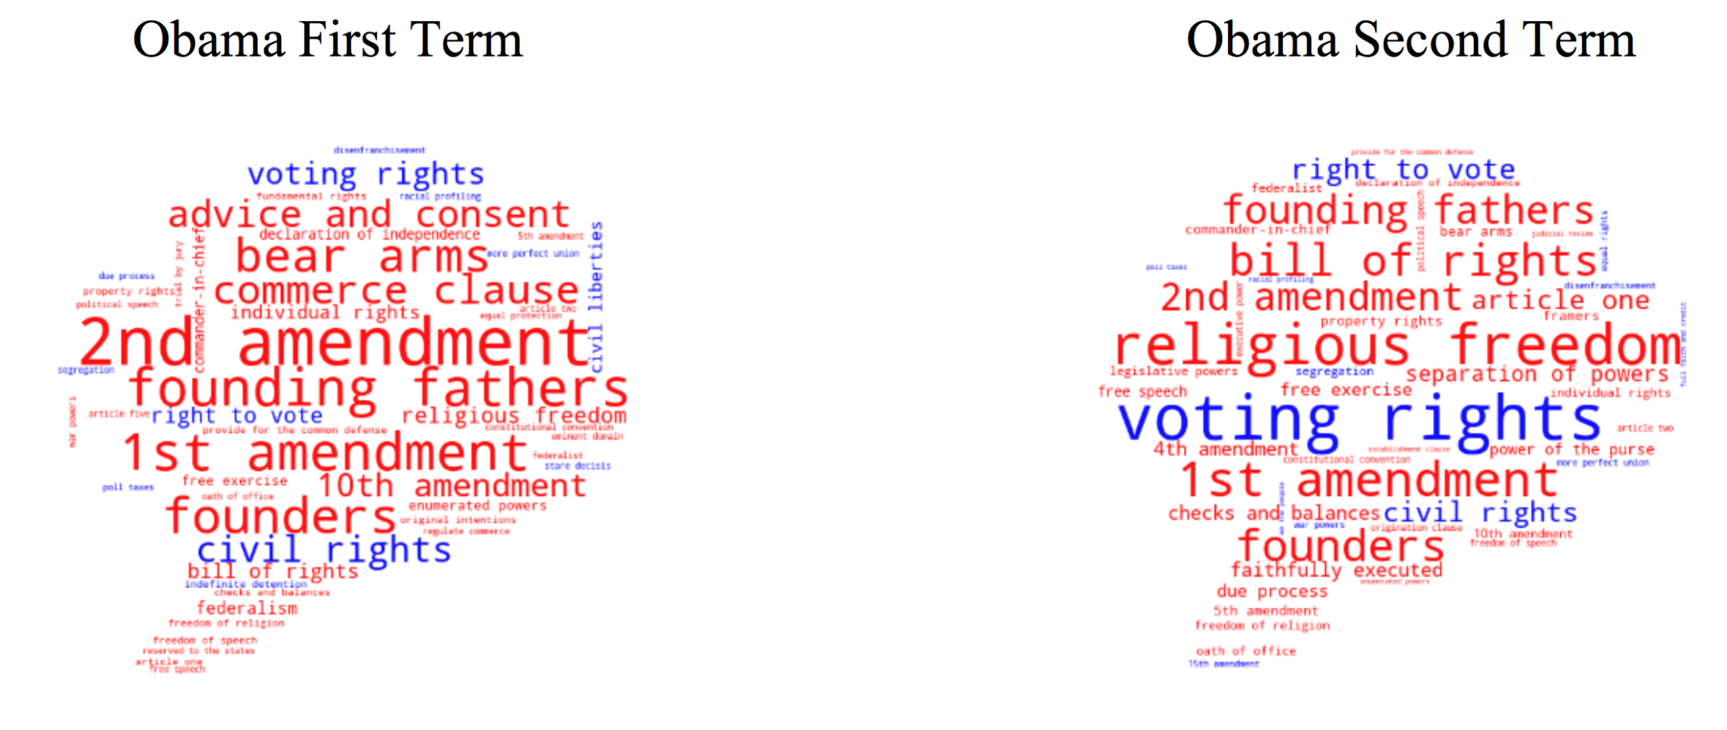
Who “Owns” Constitutional Terms?
Two Obama Administrations
Red: Republican
Blue: Democrat

Slide 23
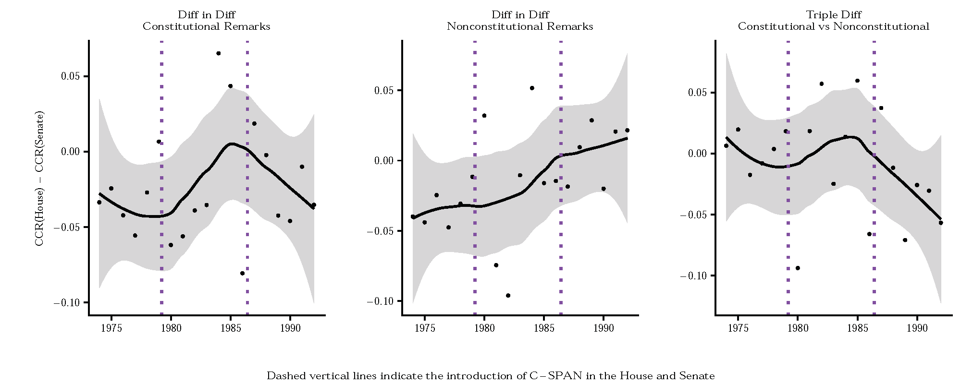
C-SPAN Effect

Slide 24
C-SPAN Effect

Slide 25
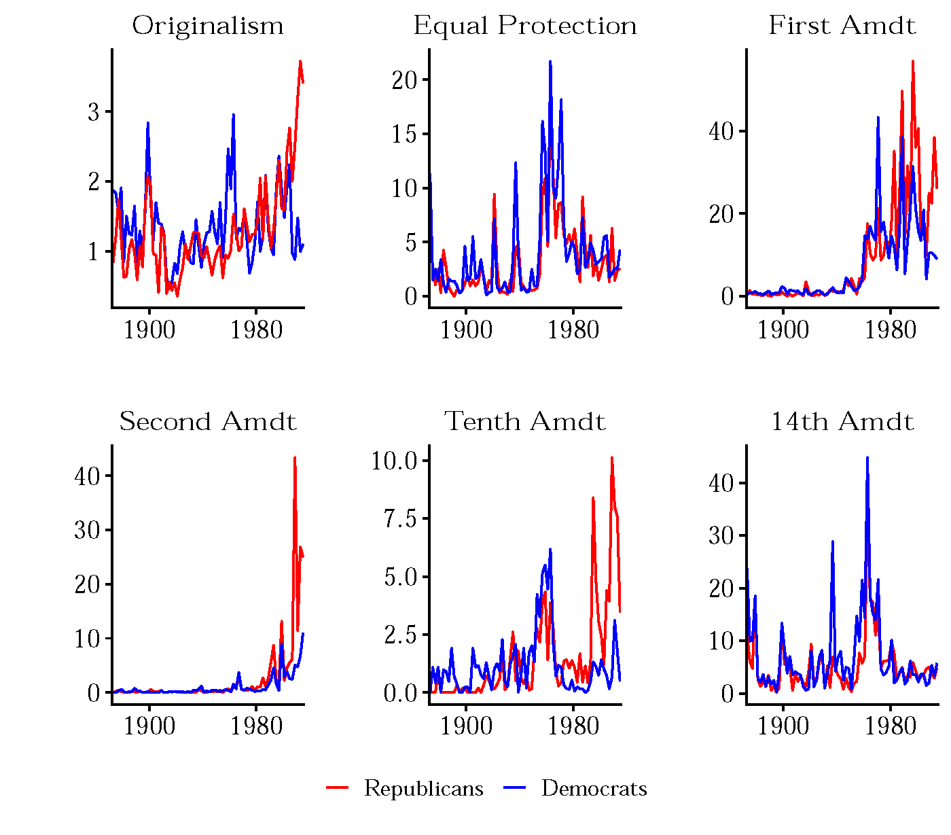
Partisan Discrepancies in Discourse

Slide 26
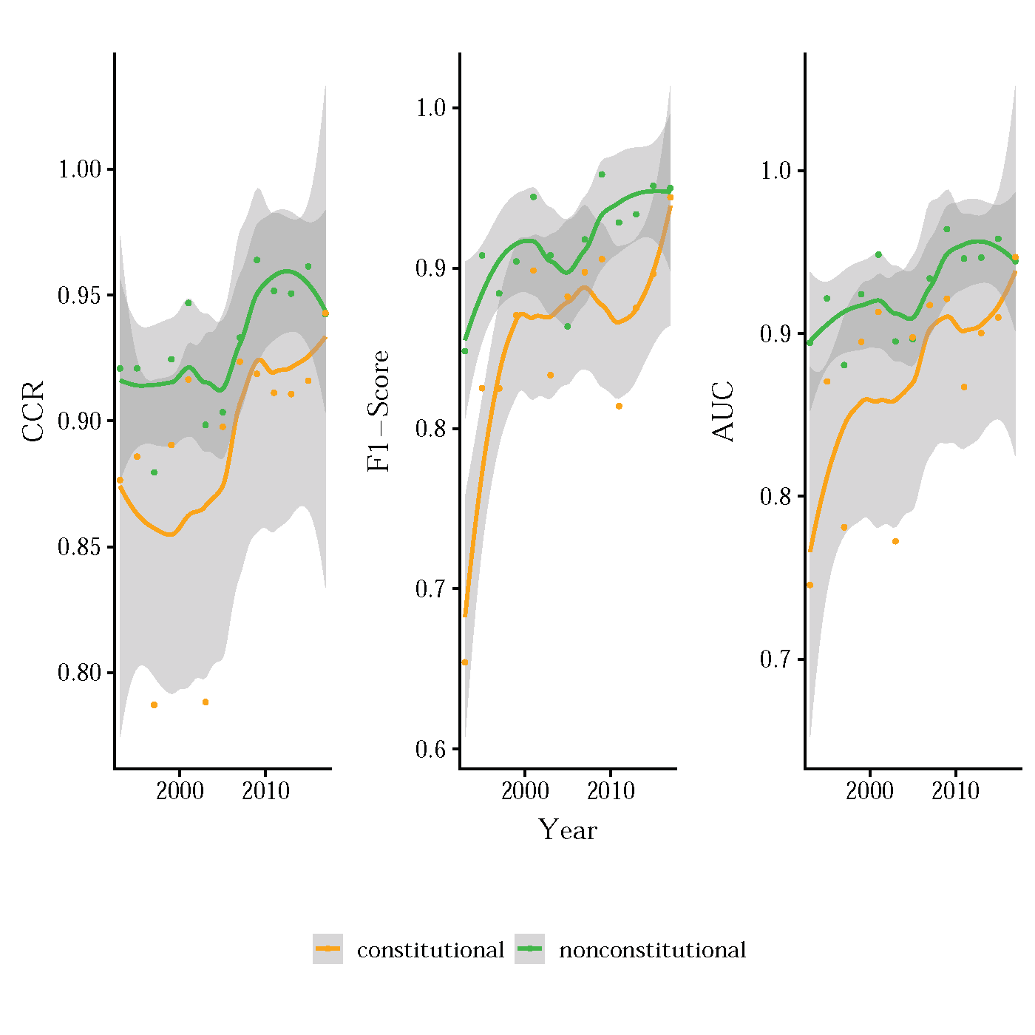
WSJ/NYT Editorials and Constitutional Polarization

Slide 27
So What?
Intrinsically interesting to those who think about constitutional discourse: all con law scholars, many political scientists and theorists, historians, etc.
Understanding nature of constitutional debate: “dialogue” v. “parallel play.” Does the Constitution really serve as a focal point and common ground for democratic life?
Understanding whether policy outcomes are result of informed deliberation or uninformative partisanship
New way to measure, over time, polarization and extent to which constitutional argument has become “weaponized” political argument

Slide 28
Extra Slides
David Pozen, Eric Talley & Julian Nyarko

Slide 29
Hypotheses
Main Hypothesis: Increase in polarization of constitutional discourse
  1.A: No difference between constitutional and non-constitutional discourse
  1.B: Polarization in constitutional discourse exceeds that of non-constitutional discourse
  1.C: Polarization in non-constitutional discourse exceeds that of constitutional discourse
2: Controlling for which party holds the presidency, Republicans have come to invoke the Constitution more often than do Democrats when discussing public policy.
3: When discussing the Constitution, conservatives are, and have grown, more likely to invoke terms related to originalism and the founding.
4: Members of Congress not from the president’s party are more likely to use constitutional terms associated with enforcing the separation of powers and to accuse the president of acting unconstitutionally.
  This dynamic has grown more acute since the 1970s.

Slide 30
Additional Hypotheses (I)
1.A: Prior to the 1940s, the Constitution was more likely to be invoked in discussions of the economy, economic inequality etc.
1.B: In the early part of the twentieth century, the Constitution was invoked by members of Congress less frequently, and with less reverence, than it was in subsequent decades.
1.C: Constitutional polarization is more pronounced among the blog posts than among the newspaper editorials or the statements in the Congressional Record.
2.A: When discussing the Constitution, Republicans/conservatives have become more likely to invoke terms associated with individualism, limited government, federalism, gun rights, and religious liberty. In contrast, Democrats/liberals are more likely to invoke terms associated with federal power, equality, justice, and civil rights.
2.B: First Amendment rhetoric has become increasingly identified with conservatives/Republicans since the 1970s.

Slide 31
Additional Hypotheses (II)
2.C: When discussing the Constitution, liberals/Democrats are more likely to invoke, and to speak positively about, standard-like provisions such as “due process,” “equal protection,” “unreasonable searches and seizures,” and “cruel and unusual.”
2.D: When discussing the Constitution, conservatives have become more likely than liberals to ground the discussion in specific textual provisions or in Supreme Court decisions.
2.E: When discussing the Constitution, and especially when discussing the other side’s actions or views concerning the Constitution, conservatives are more likely to use negative, fearful rhetoric.
2.F: When discussing the Constitution, conservatives are more likely to use terms associated with truth claims and necessitarian logic, while liberals are more likely to use terms associated with moral and policy goods.
  When discussing the Constitution, conservatives are more likely to speak in a confident, unambiguous register.

